Slide 1
The glue that binds us all:
Imaging matter below the Fermi scale with an Electron-Ion Collider
Raju Venugopalan
Brookhaven National Laboratory
The glue that binds us all:
Imaging matter below 10⁻¹⁵ m with an Electron-Ion Collider
Raju Venugopalan
Brookhaven National Laboratory
FSU, Nuclear Physics Seminar
November 10, 2017

Slide 2

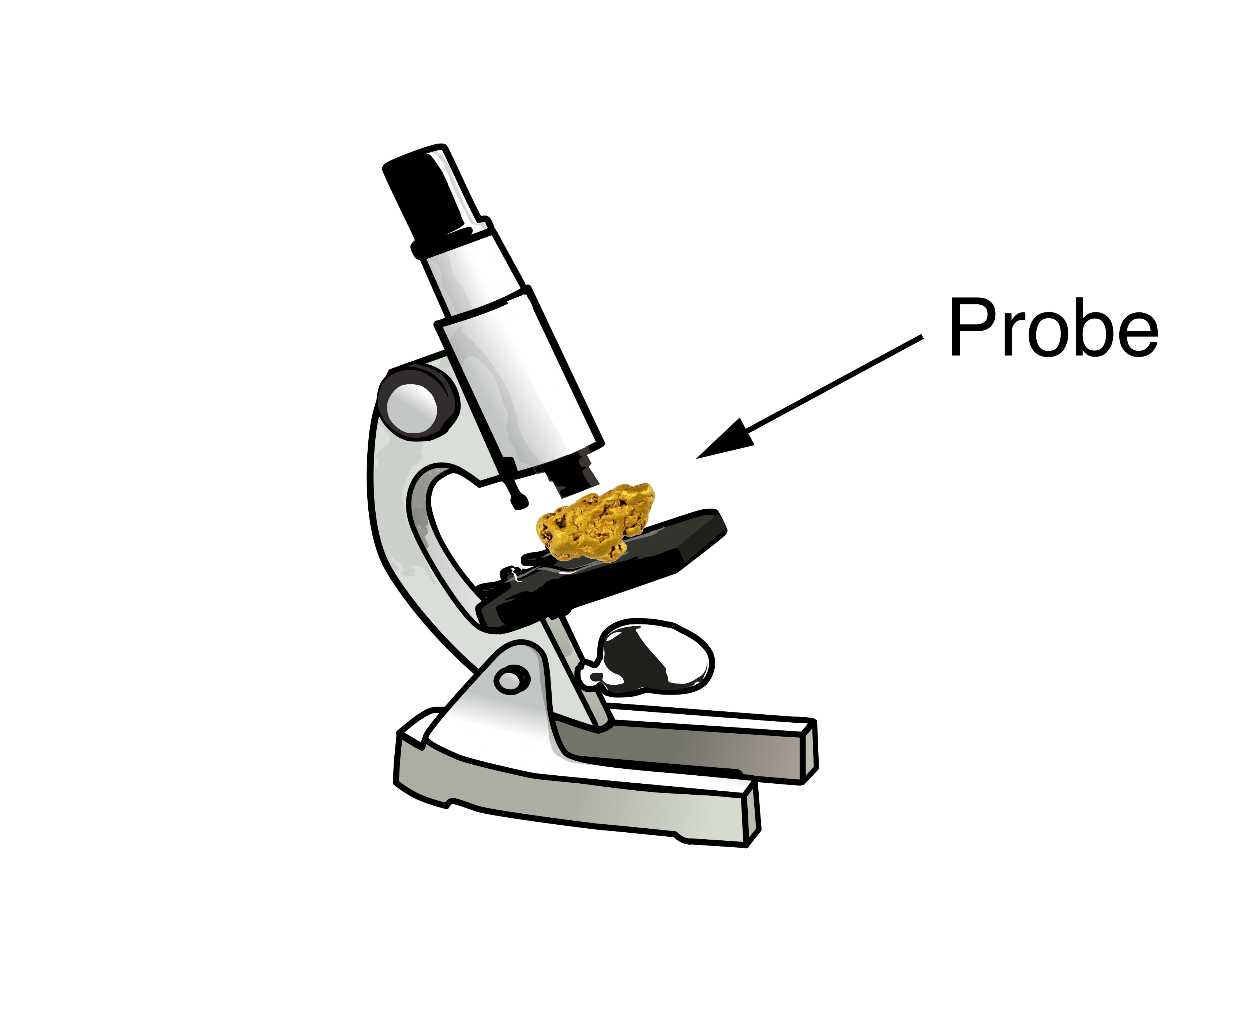
Structure of matter: Microscopes to Femtoscopes
Light Microscope
Wave length: 380-740 nm
Resolution: > 200 nm
SLAC,EMC,NMC,E665,BCDMS,
HERMES,JLab,COMPASS…
JLab 12 GeV
Electron Microscope
Wave length: 0.002 nm (100 keV)
Resolution: > 0.2 nm
HERA,
EIC,LHeC
Fixed Target Particle
Accelerator Experiments
Wave length: 0.01 fm (20 GeV)
Resolution: ~ 0.1 fm
Collider Experiments
Wave Length: 0.0001 fm
(10 GeV + 100 GeV)
Resolution: 0.01-0.001 fm

Slide 3
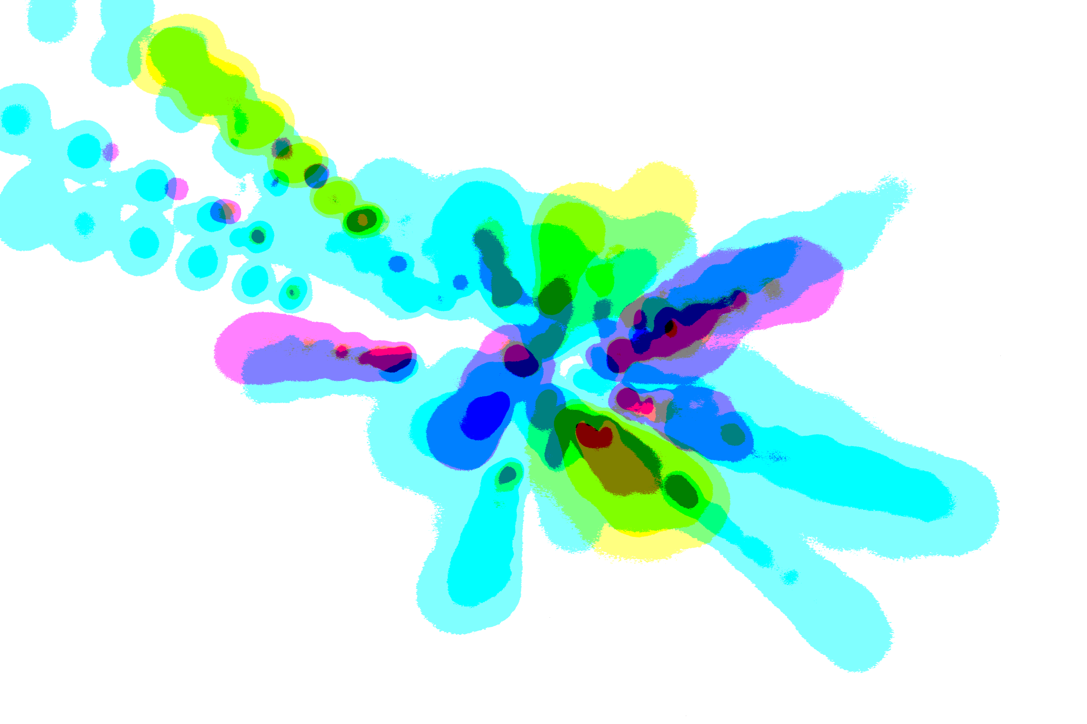
Science case for an EIC
A study of origins in four acts:
the essential mystery, what we know,
what we would like to know, and…how to get there

Slide 4
Act 1: The mysterious gluon

Slide 5
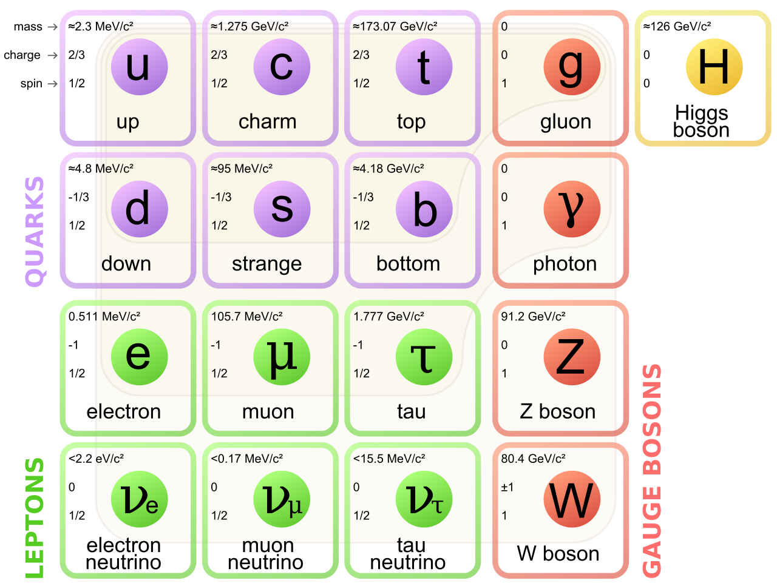
Gluons, the force carriers of the strong force,
are a fundamental building block of the standard model

Slide 6
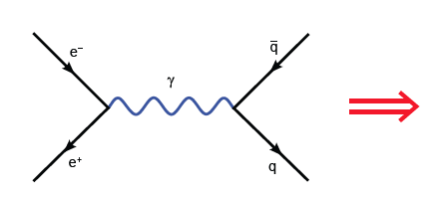
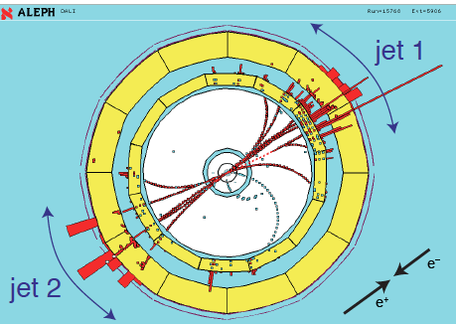
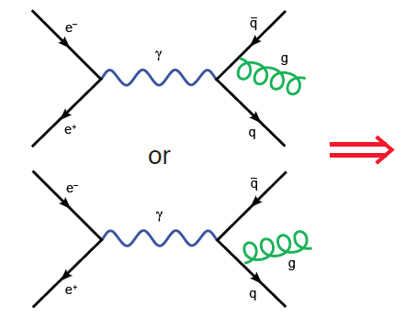
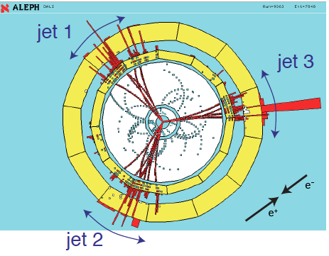

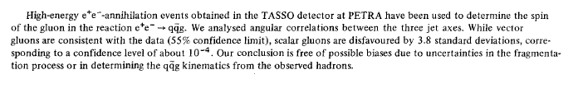
Discovery of the gluon
Physics Letters B, 15 December 1980

Slide 7
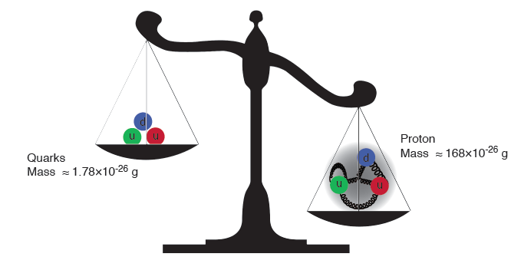
Gluons are massless…yet their dynamics is responsible for
(nearly all) the mass of visible matter
The Higgs “God particle” is responsible for quark masses
~ 1-2% of the proton mass.

Slide 8
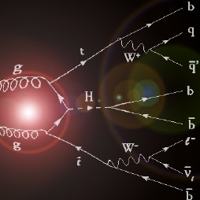
Higgs from Gluon fusion

Slide 9
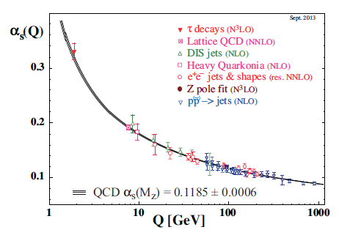
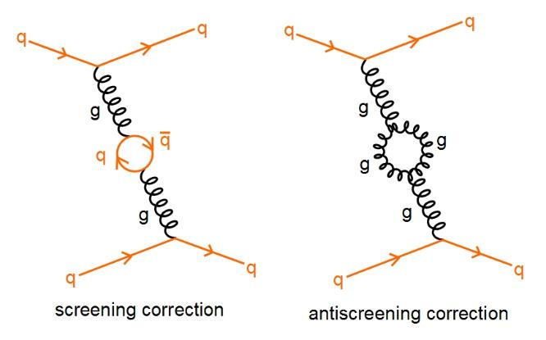

Asymptotic freedom: the role of glue
David Politzer
2004
David Gross
Frank Wilczek
The self-interaction (of color charged) gluons is fundamentally responsible for
the asymptotic freedom of quarks and gluons in Quantum Chromodynamics (QCD)

Slide 10
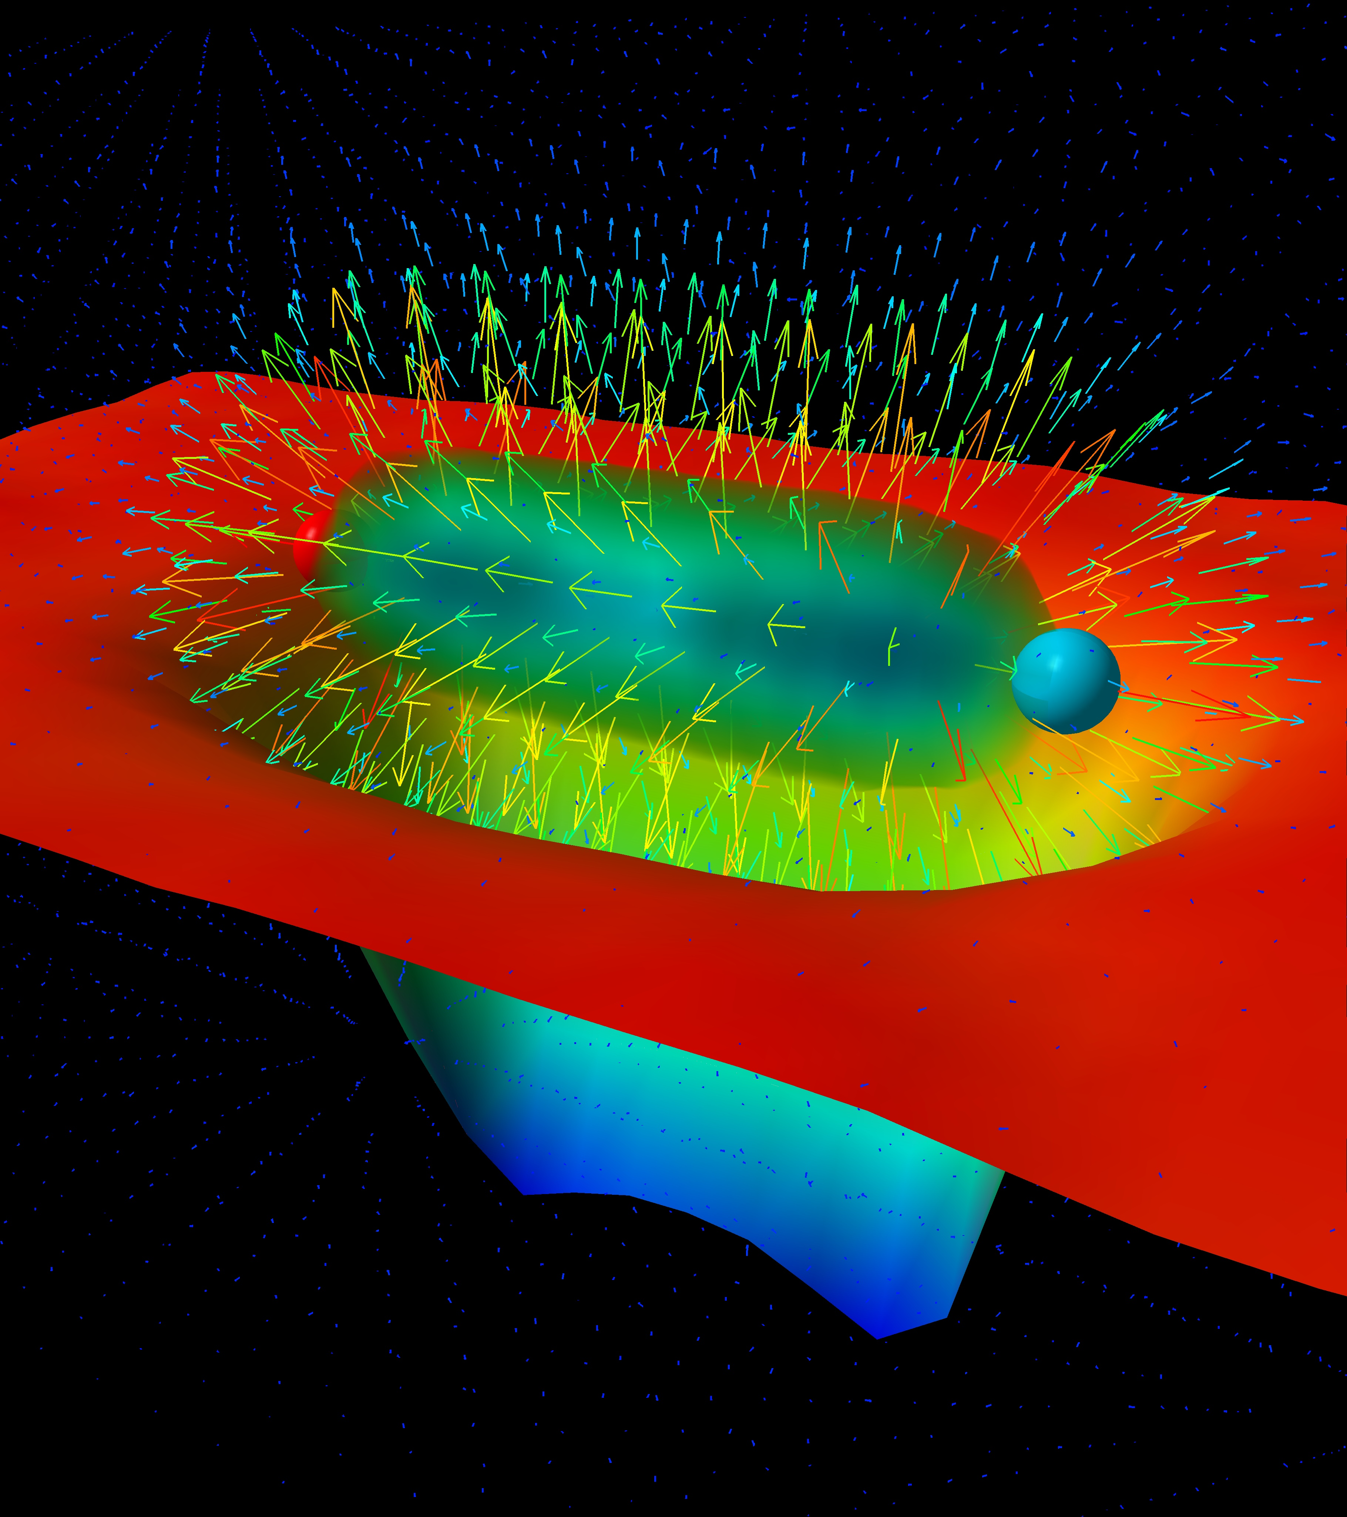
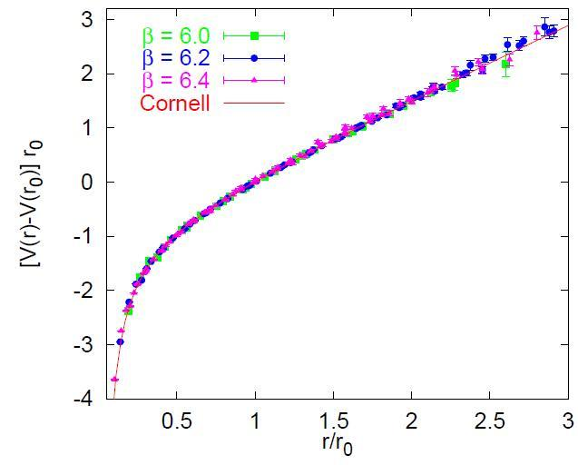
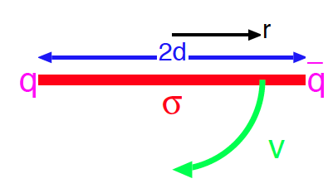
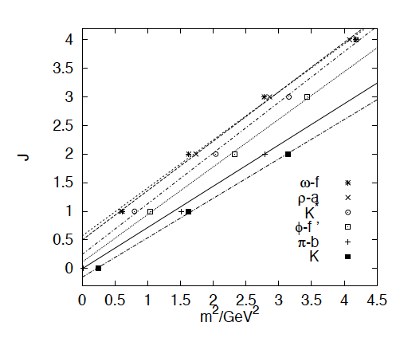
Quark (and Gluon) confinement: the role of glue ?
“Gluon” potential between
heavy quark-antiquark pair
Quarks experience force of 16 tons at
distances of ~ 1 Fermi (10⁻¹⁵ m)
Bali, hep-ph/0001312
“Regge” trajectories
Intuitive picture of quark confinement and
stringy pictures of mesons

Slide 11
The essential mystery
(Nearly) all visible matter is made up of quarks and gluons
But quarks and gluons are not visible
All strongly interacting matter is an emergent consequence of many-body quark-gluon dynamics.
Example: Mass from massless gluons and (nearly) massless quarks
There is an elegance and simplicity to nature’s strongest force we do not understand
Understanding the origins of matter demands we
develop a deep and varied knowledge of this emergent dynamics

Slide 12





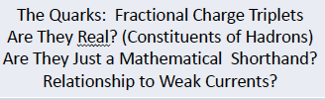


Act 2. Quantum Chromodynamics:
The Power and the Glory
From Gell-Mann’s 8-fold way to QCD: A lepidopteral metaphor
Jeffrey Mandula, Creutz-Fest 2014, BNL

Slide 13
Quantum Chromodynamics (QCD)
QCD - “nearly perfect” fundamental quantum theory of quark
and gluon fields F.Wilczek, hep-ph/9907340
Theory is rich in symmetries:
“Symmetries dictate interactions” – C.N Yang
i
ii
iii
Gauge “color” symmetry: unbroken but confined
Global “chiral” symmetry: exact for massless quarks
Baryon number and axial charge (m=0) are conserved
Scale invariance of quark (m=0) and gluon fields
Discrete C,P & T symmetries
Chiral, Axial, Scale and (in principle) P &T broken by
vacuum/quantum effects - ”emergent” phenomena
Inherent in QCD are the deepest aspects of relativistic Quantum Field Theories (confinement, asymptotic freedom, anomalies, spontaneous breaking of chiral symmetry)

Slide 14
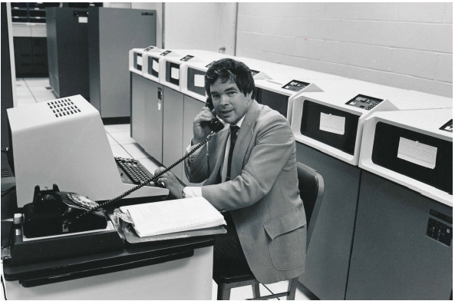
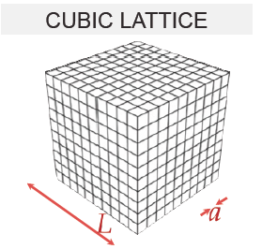
Numerical realization: Lattice QCD
(1982)
Kenneth G. Wilson
Lattice regularization (UV&IR) of QCD
First principles treatment of static
properties of QCD: masses, moments,
thermodynamics at finite T (& μ_{B} ?)

Slide 15
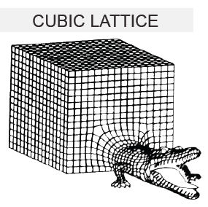
Numerical realization: Lattice QCD
(1982)
Kenneth G. Wilson
Formidable computational problem
Very challenging for dynamical
processes…

Slide 16
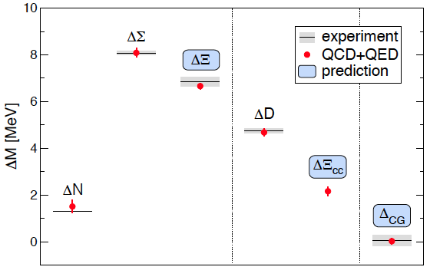
Precision QCD on the lattice
Coleman-Glashow
relation among
mass splittings
Budapest-Marseille-Wuppertal (BMW) Coll., arXiv:1406.4088

Slide 17
The deeply inelastic scattering (DIS) femtoscope
Measure of resolution power
Measure of inelasticity
Bjorken variable: Measure of momentum fraction of struck quark
quark+anti-quark
momentum distributions
gluon momentum distribution

Slide 18
The deeply inelastic scattering (DIS) femtoscope
Measure of resolution power
Measure of inelasticity
Bjorken variable: Measure of momentum fraction of struck quark
quark+anti-quark
momentum distributions
gluon momentum distribution

Slide 19
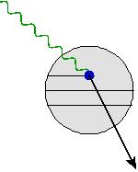
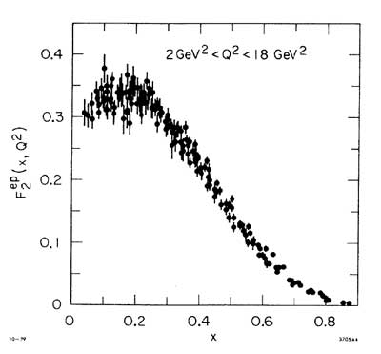
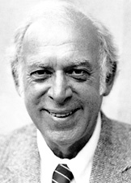
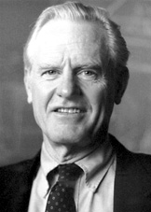

The deeply inelastic scattering (DIS) femtoscope
From SLAC fixed target
DIS… (late 1960s)
Discovery of quasi-free point-like quarks!
(1990)
Friedman
Kendall
Taylor

Slide 20

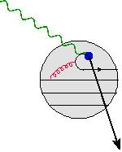
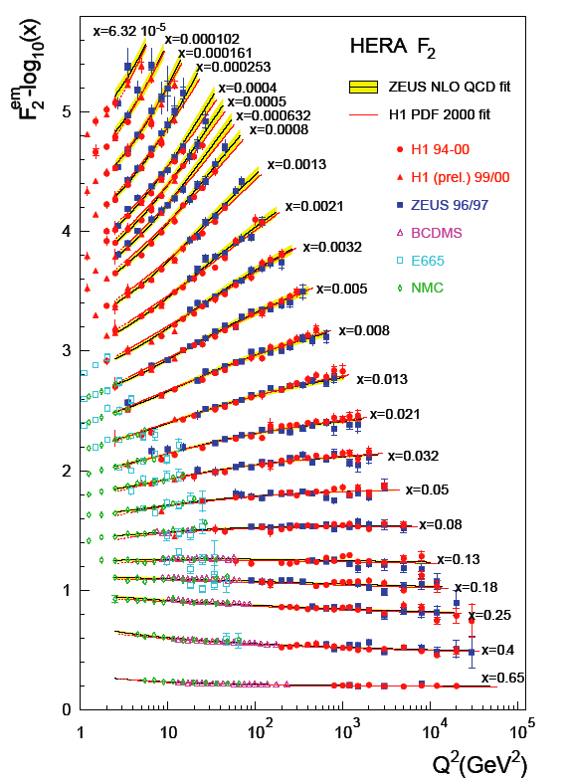
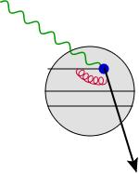
The deeply inelastic scattering (DIS) femtoscope
…to the HERA DIS collider (1990s)
Gluons and
“sea” quarks
SLAC
expts.
The proton at high energies
(small x) is dominated
by glue!

Slide 21
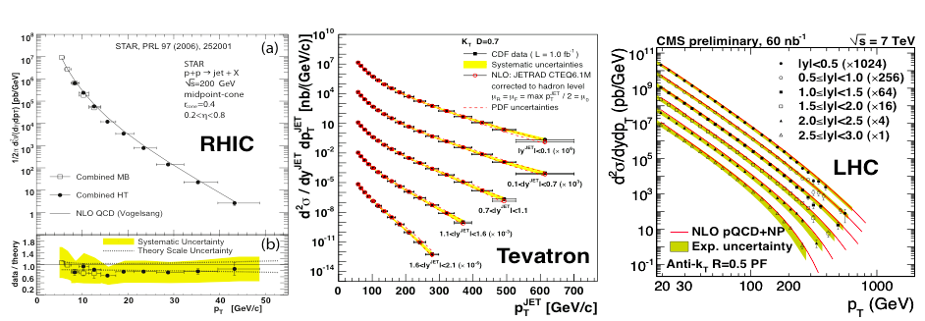
Perturbative QCD: now benchmark for new physics
Structure functions measured at
HERA electron-proton collider
Jet cross-sections: proton-proton collisions (RHIC &LHC)
and proton-antiproton collisions at Fermilab
At large momenta, the weak QCD coupling
(asymptotic freedom!) enables
systematic computations

Slide 22
F. Wilczek , “Quarks (and Glue) at the Frontiers of Knowledge”
Talk at Quark Matter 2014
Are we done ?

Slide 23
Act 3. Frontiers of our ignorance

Slide 24
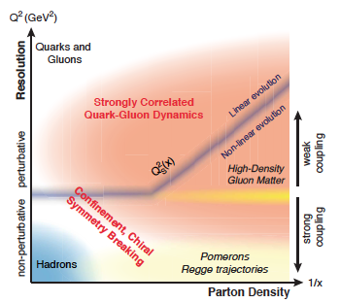
Scattering in the strong interactions
arXiv:1708.01527
Perturbative QCD describes only a small part of the total cross-section
Lattice QCD is of very limited utility in describing scattering
Effective theories: how do quark and gluon degrees organize themselves
to describe the bulk of the cross-section ?

Slide 25
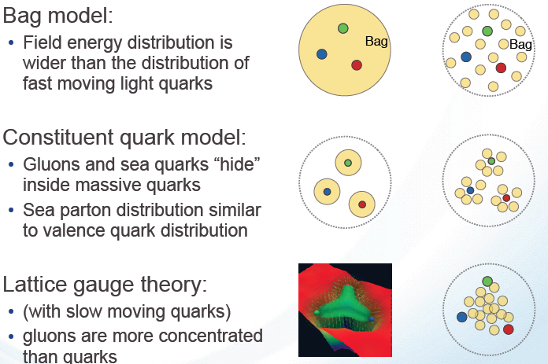
What does the proton look like ?
Static pictures
Glue dominated
boosted proton

Slide 26
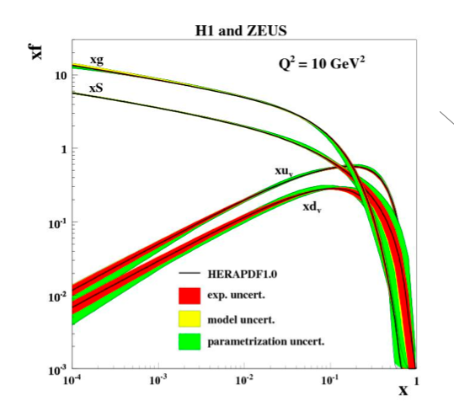
The boosted proton
In QCD, the proton is made up of quanta that fluctuate in and out of existence
Low Energy
or large x
High Energy
or small x
Wee parton fluctuations time dilated on strong interaction time scales
Long lived gluons can radiate further small x gluons…
Is the proton a runaway popcorn machine at high energies ?

Slide 27

The boosted proton

Slide 28
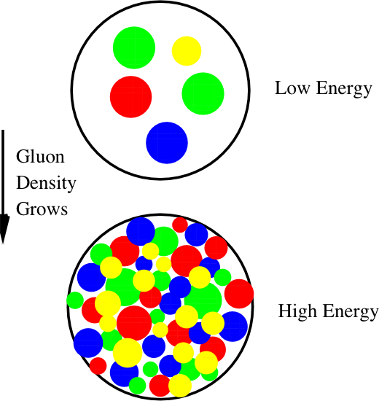
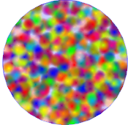
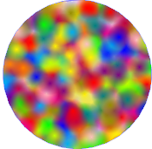
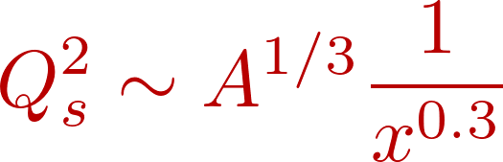
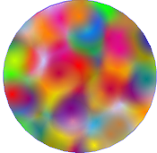
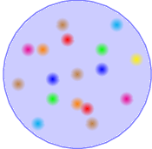
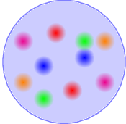

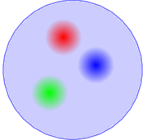


Boosted protons: classical coherence from quantum fluctuations
Emergent dynamical saturation
scale grows with energy
Powerful ``Wilsonian” RG equations
describe evolution in this landscape
Saturation
BFKL
1/Q_{S}²
DGLAP
How does this happen? What are the right degrees of freedom?
How do correlation functions of these evolve?
Is there a universal fixed point for RG evolution? Does the coupling run with Q_{s}² ?
How does saturation transition to chiral symmetry breaking and confinement?

Slide 29
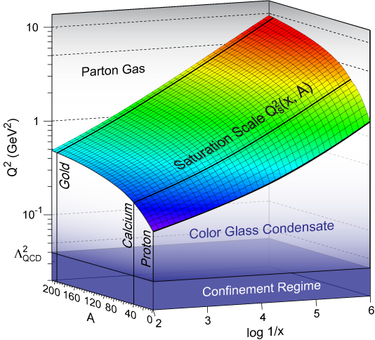
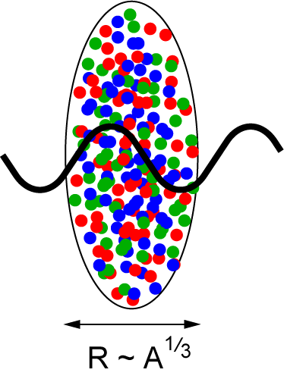
Many-body high energy QCD: a new frontier
A^{1/3} enhancement
of saturation scale in nuclei
resolution
nuclear size
energy
Dynamically generated semi-hard “saturation scale” opens window for
systematic weak coupling study of non-perturbative dynamics
Can we sneak up on confining dynamics “through the back door” ?

Slide 30
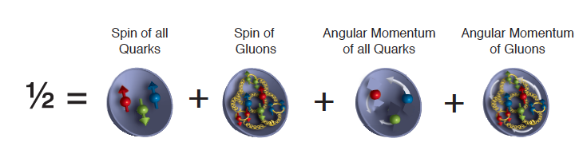
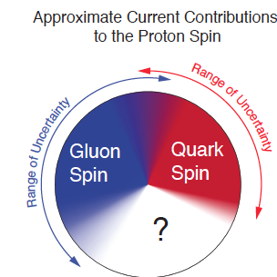
The proton’s spin puzzle
Fixed target deep inelastic scattering experiments
showed that quarks carry only about
30% of the proton’s spin
“Spin crisis” – a failure of the quark model
picture of three relativistic “constituent” quarks

Slide 31
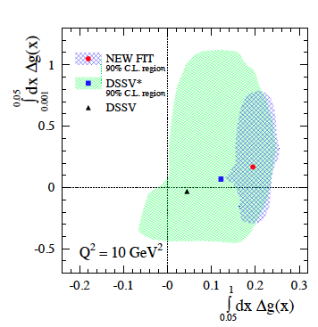
The proton’s spin puzzle
Clear evidence for gluon
polarization from RHIC polarized
proton-proton data
Gluons carry ~ 20-40 % of the
Proton spin
Where’s the rest ?
D. De Florian, R. Sassot, M. Stratmann, W. Vogelsang, PRL 113 (2014)

Slide 32
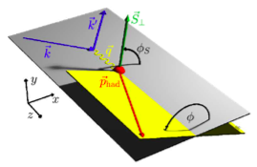

Imaging distributions of quarks and gluons ?
Transverse momentum dependent (TMD) distributions
Similar for gluons
e’
γ
e
γ_{L}*
(Q²)
x+ξ
x-ξ
~
~
p
H, H, E, E (x,ξ,t)
p’
t
Generalized parton distributions (GPDs)
Differential images correlating the spin, momentum and spatial distributions will provide fundamental insight into quark-gluon dynamics in nucleon structure

Slide 33
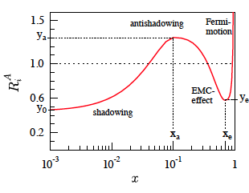
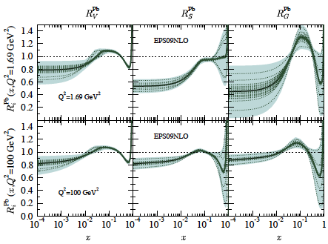
Nuclear glue: terra incognita
Quark (Gluon) distributions in nuclei- not simple superpositions
of nucleon Quark (Gluon) distributions

Slide 34
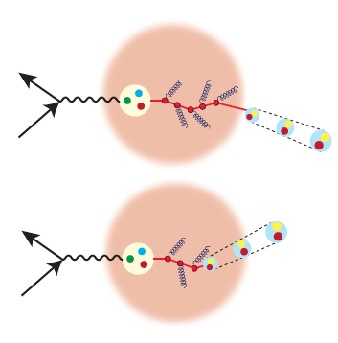
Nuclear glue: terra incognita
Quark (Gluon) distributions in nuclei- not simple superpositions
of nucleon Quark (Gluon) distributions
The nucleus as a QCD laboratory :
Understand how quarks and gluons fragment
and hadronize in and out of the medium
What is the quark-gluon nature of
nuclear short-range correlations ?

Slide 35
Act 4. EIC: the ultimate QCD machine?
The world’s first polarized electron-polarized proton collider
The world’s first electron-heavy ion collider
Luminosities: a hundred to up to a thousand times HERA
Fine resolution inside proton down to 10⁻¹⁸ meters

Slide 36
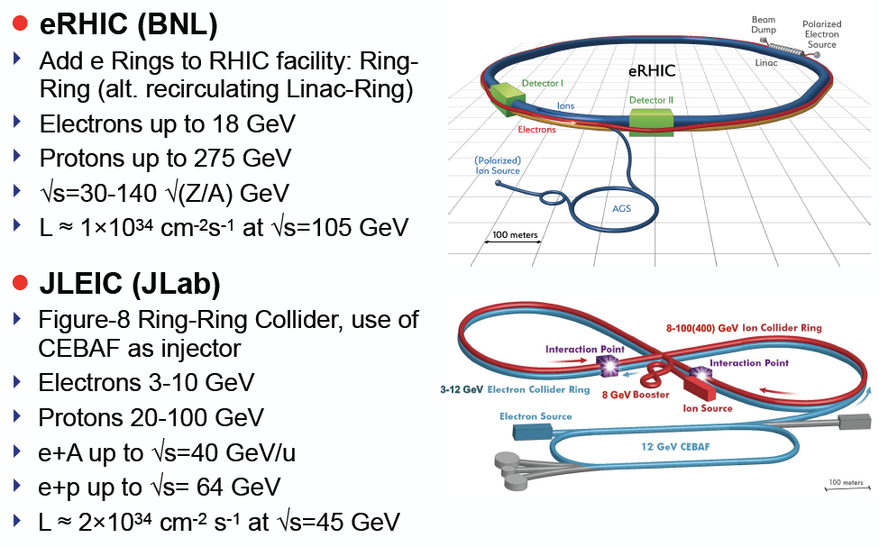
US Electron-Ion Colliders: accelerator designs
LHeC at CERN – center-of-mass energies of 1.2 TeV (4 times HERA)
electron-ion collisions; no polarized protons

Slide 37


Select measurements
arXiv:1212.1701v3
arXiv:1708.01527

Slide 38


Resolving the proton’s spin puzzle
-
dramatic reduction
of uncertainties:
world data
until eRHIC
now
eRHIC

Slide 39


Money plot
Nail down the valence, sea quark, gluon
and orbital contributions to the proton’s spin

Slide 40

Entering terra-incognita in nuclei
Current knowledge on distributions of quarks and gluons in nuclei

Slide 41


Entering terra-incognita in nuclei
Dramatic improvement in precision extraction of nuclear gluons and sea quarks
- factors of 4 – 8 reduction in present uncertainties…

Slide 42

The Transubstantiation of Quarks and Glue into mesons and baryons
Nu is a coherence length. Dialing it determines
whether quarks (gluons) fragment in or out of nucleus
Novel sensitivity to heavy quark
fragmentation

Slide 43

Diffraction for the 21st Century
M_{X}
Colorless
exchange
A TeV electron hits a nucleus (binding energy of 8 MeV/nucleon)
Day 1: prediction: nucleus remains intact in at least 1 in 5 events

Slide 44


Diffraction for the 21st Century
TeV electron hits a nucleus with binding energy ~ 8 MeV/nucleon)
Day 1: prediction: nucleus remains intact in at least 1 in 5 events

Slide 45

EIC whitepaper
New opportunities

Slide 46



Short-range nucleon-nucleon correlations
Topic of much interest:
Striking data on p-n versus p-p and n-n correlations from Jlab
Dominance of tensor component of
Nucleon-Nucleon potential?

Slide 47

Probing short-range NN interactions with EIC
Miller, Sievert, Venugopalan, PRC93 (2016), 045202
Exclusive process:
rapidity gap
Trigger on process with T = Δ² ≈ -Δ_{T}² ≈ -Λ_{QCD}² and p’_{T}² >> Λ_{QCD}²
Proton and neutron produced with large back to back transverse momenta

Slide 48




Short-range nucleon-nucleon interactions with EIC
Miller,Sievert,RV,in preparation
Clean separation of scales of upper vertex
in the high energy ``Regge” limit:

Slide 49


Slide 50






Short-range nucleon-nucleon interactions with EIC
Transition Generalized Parton Dist.
In collider kinematics, T-GPD factorizes in the Light Front Framework

Slide 51




Short-range nucleon-nucleon interactions with EIC
Factorization of time scales
also occurs for lower vertex
Deuteron light front
wave function:

Slide 52


Short-range nucleon-nucleon interactions with EIC
For large relative transverse momenta, p’_{T}² >> Λ_{QCD}², perturbative expansion of V_{NN}
The EIC can therefore provide information about
the gluon structure of short range nuclear forces!
Note: previous discussions of ``multi-pomeron” contributions to short range forces
– and neutron star masses Rikjen et al. , arXiv: 1406.4332, 1308.2130

Slide 53
Concluding Thoughts
Our knowledge of the fundamental structure of matter is clouded
by the vast fog of our ignorance
– though there are bright gems that shine through
At the heart of the matter is the confining dynamics of QCD –
this is many-body dynamics with gluons playing a lead role.
Addressing this requires deep and varied knowledge
– an EIC enables unique and unprecedented measurements.
The history of DIS informs us that surprises may be anticipated

Slide 54


Scientific American
May 2015 issue

Slide 55


Slide 56

Slide by Thomas Ullrich

